Slide 1
NOT-MH-18-014 description of Scientific Analysis Unit:
The Scientific Analysis Unit is organized to generate new methodology and apply state of the art analytic approaches to the fields of big data science, health services research, and implementation science. The unit should provide consultation and analytic support for network and affiliated projects to develop, identify, and engage putative change mechanisms in health system research.

Slide 2
Two roles for scientific analysis unit:
Consultation – Standard methods are adequate to the task, but all members may not have specific expertise to select the appropriate method.
Methods development – Standard methods just won’t do.
Notes:
Consultation – Standard methods are adequate to the task, but all members may not have specific expertise to select the appropriate method.
- I added the selection piece. Consultation should not include implementing methods that folks don’t have the expertise to implement or holding the hand of folks not able to implement the methods. People have a tendency to abuse “consulting” I am waring of setting myself up for that.

Slide 3
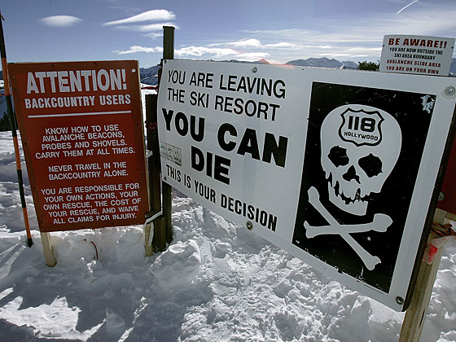
Ski slope analogy:
Greg can do it
Greg can do it with some basic advice
There’s an R package that works OK
Could be fun, but you’d better know what you’re doing
Notes:
What slide is this for? For the black diamond, I don’t want to be on the hook for teaching a programmer to implement complex analyses. I don’t know all of the partners we are expecting to work with so I am just being cautious by bringing this up now.

Slide 4
Our analytic challenges:
Parametric modeling with hierarchical/clustered data.
Accounting for confounding in one-time choices (e.g. propensity scores, inverse probability weighting)
Free text processing and text mining
Variable selection approaches and machine learning methods
Accounting for confounding in dynamic choice scenarios
Machine learning with clustered data
Notes:
I added clustered.
I changed the second bullet
I made a change in slide 4
Also made a change in the last bullet

Slide 5
Our analytic challenges:
Parametric modeling with hierarchical data.
Accounting for confounding in one-time choices (e.g. propensity scores, inverse probability weighting)
Free text processing and text mining
Variable selection and other machine learning
Accounting for confounding in dynamic choice scenarios
Machine learning in clustered data scenarios
Notes:
Just carry over changes from previous slides

Slide 6
Our analytic challenges:
Parametric modeling with hierarchical data.
Accounting for confounding in one-time choices (e.g. propensity scores, inverse probability weighting)
Free text processing and text mining
Variable selection and other machine learning
Accounting for confounding in dynamic choice scenarios
Machine learning in clustered data scenarios

Slide 7
Two models for “consultation and analytic support”:
“Federated” model
  Projects expected to have adequate expertise and resources to accomplish aims
  Central role is convening, suggesting, and facilitating spread of new methods
“Centralized” model
  Projects rely on core resources for analysis
  Requires substantially more central resources

Slide 8
The real challenge:
How to do this for $20 or less…
When we can’t expect flexibility with unspent funds.

Slide 9
Related projects (actual and anticipated):
New suicide risk prediction supplement
  Emphasis on alternative machine learning methods
  Only lasts until July 2019 (end of current funding cycle)
Susan Shortreed’s IMATS R01
  Methods for inference in complex or dynamic treatment choice scenarios
  Anticipated: 8/2018 to 7/2021
Proposed pilot project on anti-suicide effect of ketamine-like drugs
  Involves both machine learning methods and causal inference in complex treatment choice scenarios
  Likely start in 2020 or 2021
Notes:
I would change dynamic to “complex treatment” as even if the treatment is one point in time (i.e. not dynamic) I still think we have some challenges here based on confounding by indication. I have not had a chance to read the methods papers of the stuff I learned about while I ENAR. I don’t think it will completely solve our probably, but it does propose a new line of attack.

